Slide 1
Chaim Sanders & Franziska Bühler
The OWASP Core Rule Set
-
Crafting A Security Focused DevOps Program
Notes:
Chaim

Slide 2

Outline
2. DevOps in CRS Project
3. CRS in your Project
1. Intro WAF / CRS
Notes:
Chaim

Slide 3
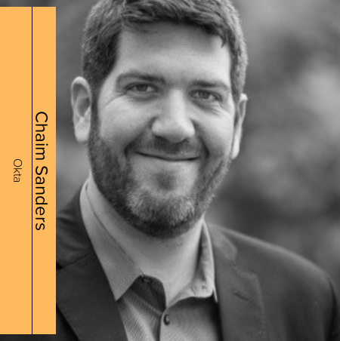


Who are we ?
CRS Co-Lead
Okta
CRS Developer
Puzzle ITC
@bufrasch
Notes:
Chaim / Franziska

Slide 4
Outline
2. DevOps in CRS Project
3. CRS in your Project
1. Intro WAF / CRS
Notes:
Franziska
What is a web application firewall and what is the Core Rule Set?

Slide 5
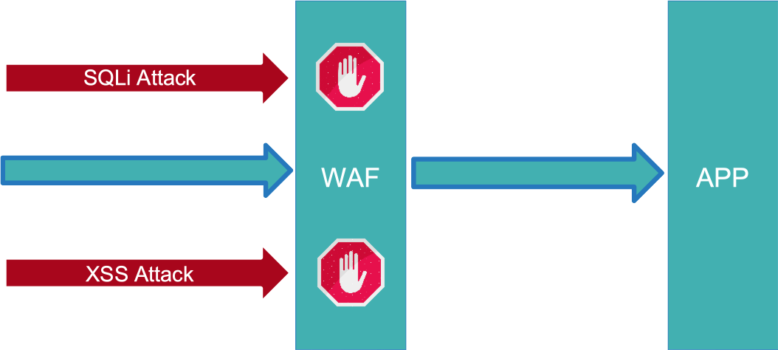

Web Application Firewall (WAF)
Notes:
Franziska
know what a WAF is
first line of defense against web app attacks
application layer -> HTTP traffic
write secure code - safety net
not stop every attack

Slide 6

ModSecurity
Notes:
Franziska
One such WAF
Popular / widespread
Apache /NGINX / IIS for example
Open Source and free
Engine

Slide 7
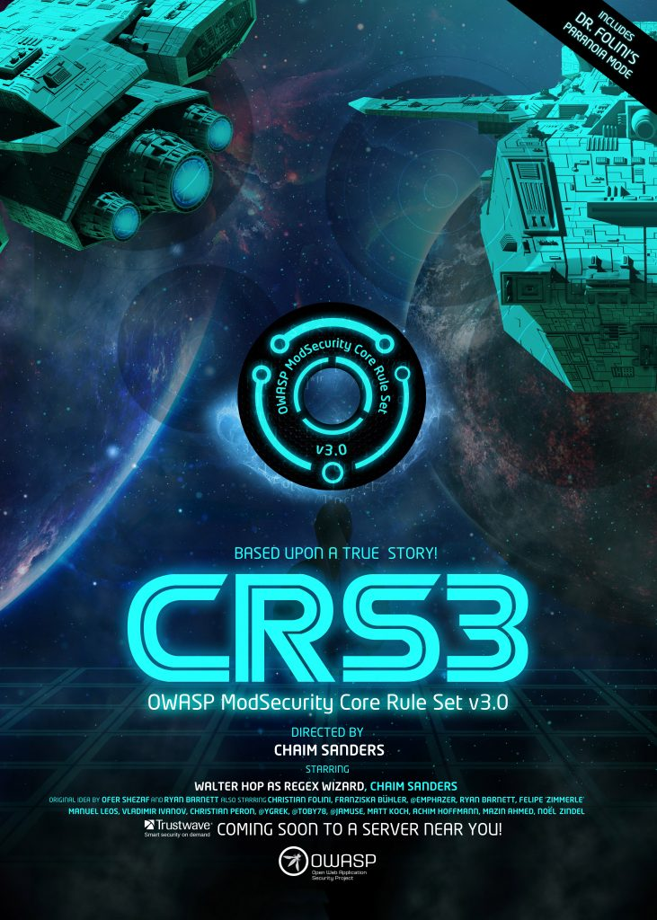

The OWASP ModSecurity Core Rule Set
Rule Set against web app attacks
OWASP Flagship Project
Release 3.2 (September 2019)
Notes:
Franziska
Open Source Project - rules for ModSecurity
OWASP FlagShip Project (OWASP -...)
Standard rule set to fight and mainly consits of regular expressions
Released 3.2 in September

Slide 8
Outline
2. DevOps in CRS Project
3. CRS in your Project
1. Intro WAF / CRS
Notes:
Franziska -> Chaim
Hand back to Chaim

Slide 9
Web Servers
OSS WAFS
Host Yourself
Apache
NGINX
NodeJS
ModSec v2
Waflz
ModSec v3
IIS
Varnish
Others
LUA- Resty- WAF
CRS Version
2.x
3.x
3.2
Providers
Choose a Provider
Cloud- flare
Avi Networks
CPanel
Fastly
Azure
Many Others
Notes:
Chaim

Slide 10




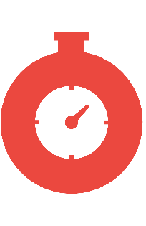


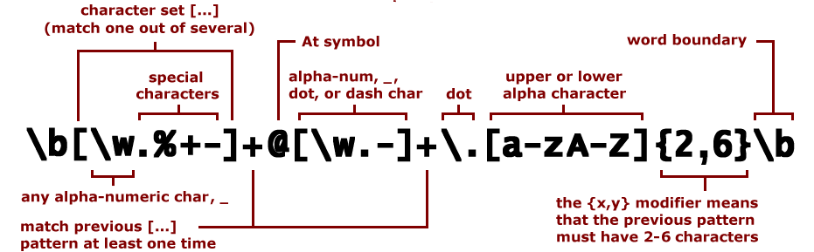
Pipeline
Other Providers
Notes:
Chaim

Slide 11
Deploy Test WAFs
Deploy FTW
Issue True Positives and True Negatives
Fix config
Expected Response
Compare to other WAFs
No
Yes

Slide 12

Why build FTW?
We love the Python Requests library
EGGS /BACON HAM
Host: localhost
Writing tests isn’t intuitive
Notes:
Chaim

Slide 13
Let’s take an example of 920170
SecRule REQUEST_METHOD "^(?:GET|HEAD)$" \
"msg:'GET or HEAD Request with Body Content.',\
id:920170,\
...
chain"
SecRule REQUEST_HEADERS:Content-Length "!^0?$" "t:none"

Slide 14
-
test_title: 920170-1
stages:
-
stage:
input:
method: "HEAD"
headers:
User-Agent: "ModSecurity CRS 3 Tests"
Host: "localhost"
Content-Type: "application/x-www-form-urlencoded"
data: "some content"
output:
status: 403

Slide 15
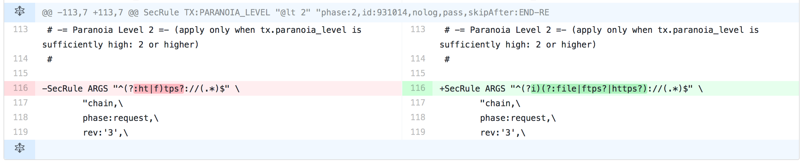
Test cases discovered issues in regular expression.
Case sensitivity
Missing schemes e.g.: file://:
Evasions reported with FTW tests to verify patches to the ruleset
*https://github.com/SpiderLabs/owasp-modsecurity-crs/pull/726

Slide 16
Outline
2. DevOps in CRS Project
3. CRS in your Project
1. Intro WAF / CRS
Notes:
Chaim -> Franziska Franziska
Chaim told us how we do DevOps in our CRS project.
NOW I will show you, how…..

Slide 17
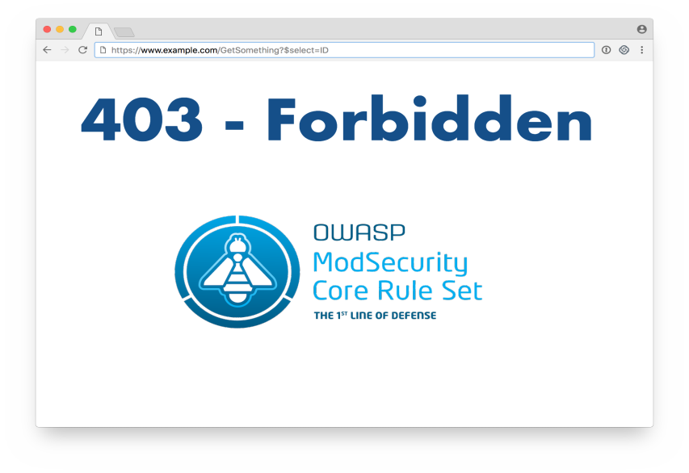
Notes:
Franziska
Picture we don’t want to see
WAFs can also block legitimate traffic
Operators and developers fear WAFs

Slide 18
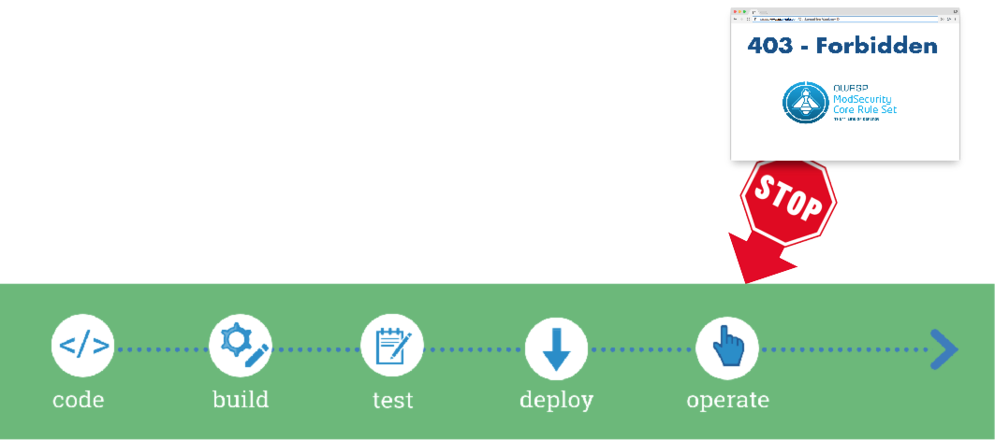
Adding CRS to your project - Too late!
Notes:
Franziska
Even worse
What happens now?
Annoying

Slide 19
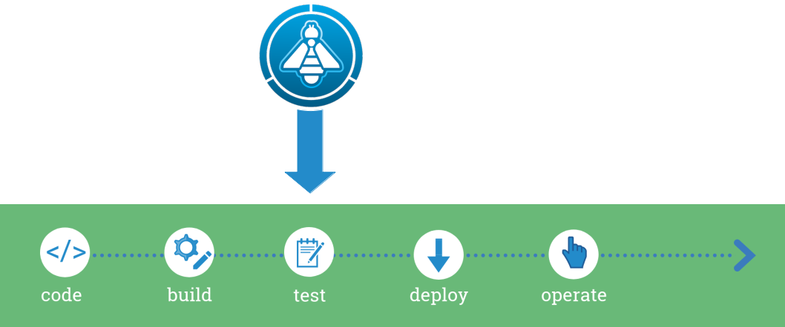
Adding CRS to your project - Test WAF!
Notes:
Franziska
Add WAF to an early stage
Automated application tests -> add WAF
And as so often: automation is the key!
I will come to that in a second.
But first I would like to explain why a WAF sometimes blocks legitimate traffic

Slide 20
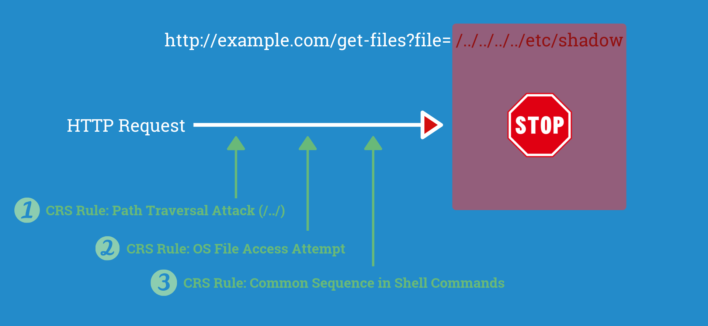
Malicious Request
Notes:
Franziska
We have to understand some CRS basics.
Here is an example of a malicious request

Slide 21
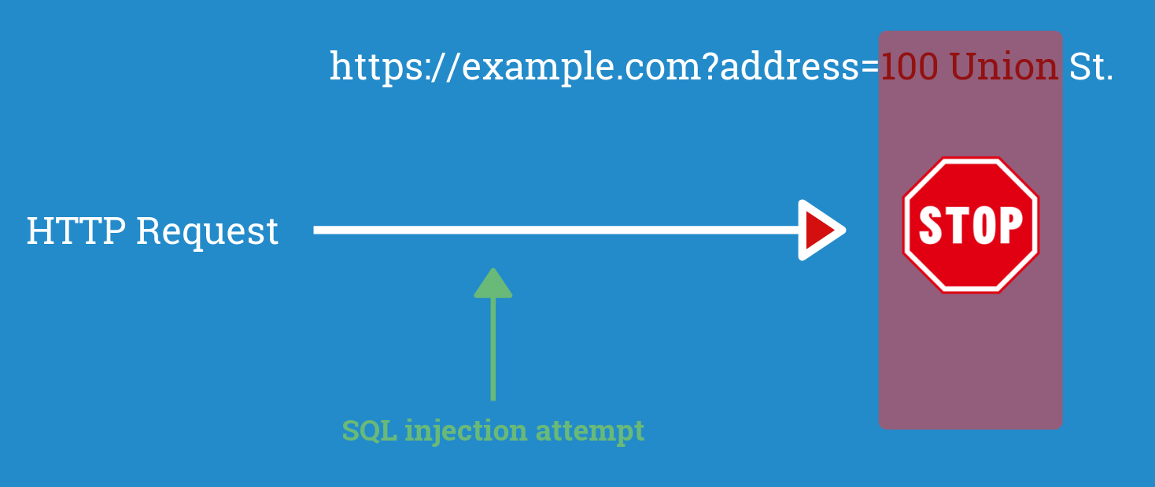
False Positive
Notes:
Franziska
Sounds good and reasonable
Problem: real world
Unfortunately…
Was reported and fixed by the CRS team

Slide 22
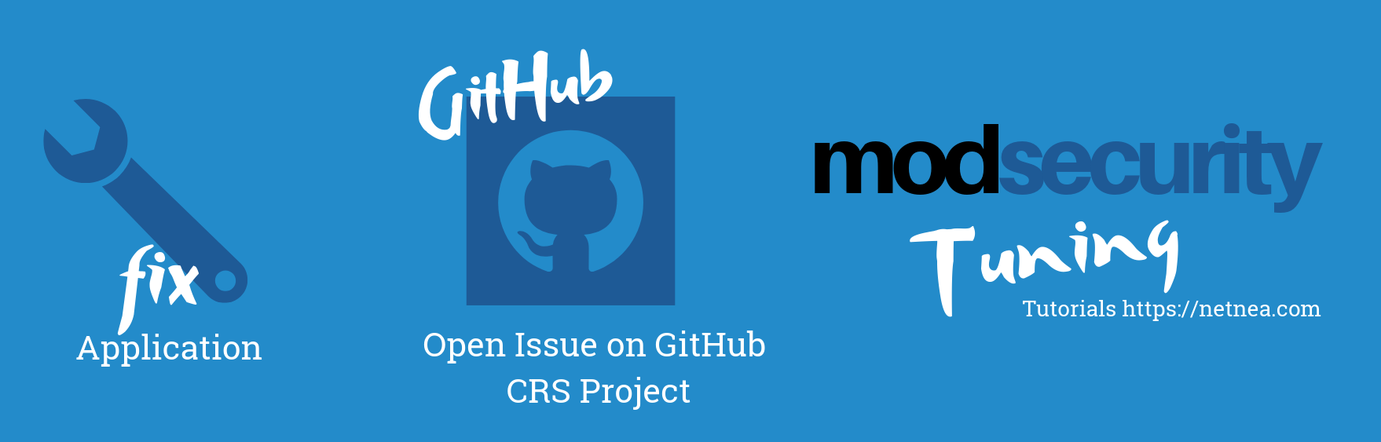
Fight False Positives
Notes:
Franziska ???

Slide 23
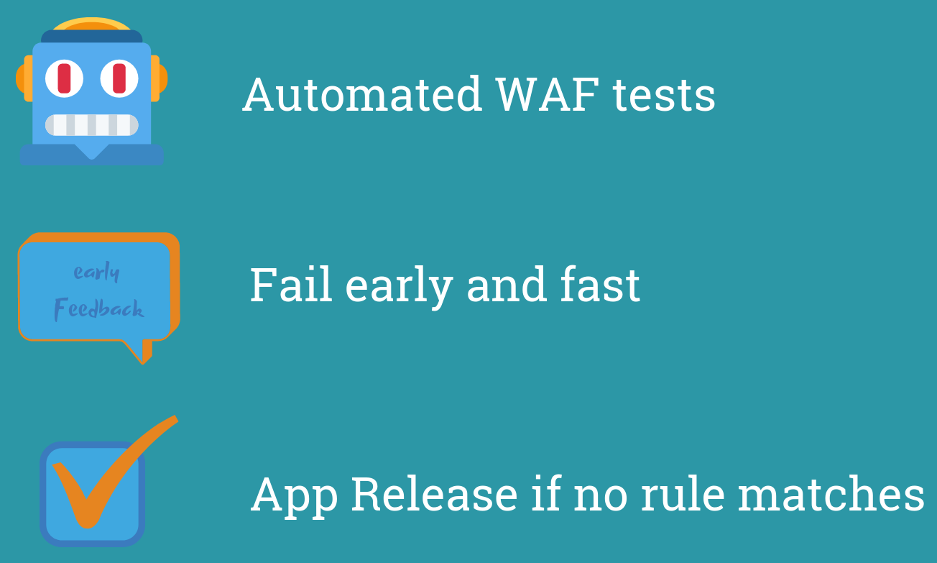
WAF in DevOps
Notes:
Franziska
Now we add a WAF to DevOps - what does that mean?
application tests with WAF - all tests succeed without and with a WAF - no CRS rules triggers
Developer early feedback and enough time to fix issues - fail early and fast - each commit… automatically started and run
App should not go to release until it is fully tested with a WAF - until error is fixed - deployable and runnable state with a WAF - we know legitimate traffic not blocked

Slide 24
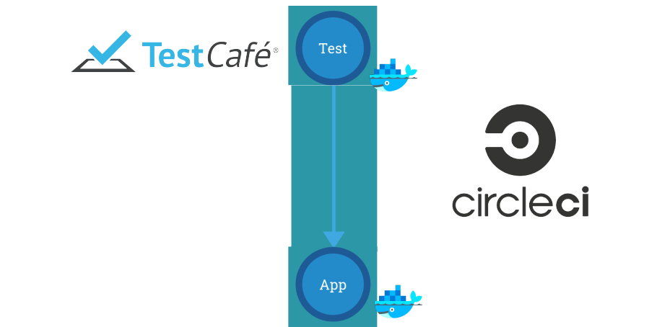
Setup
Notes:
Franziska
Let me show you a possible setup
Application tests should be green
TestCafe - Node.js tool to automate end to end web testing - Selenium - FTW
CircleCI
Each of these components in Docker container -> 2 Docker containers running

Slide 25
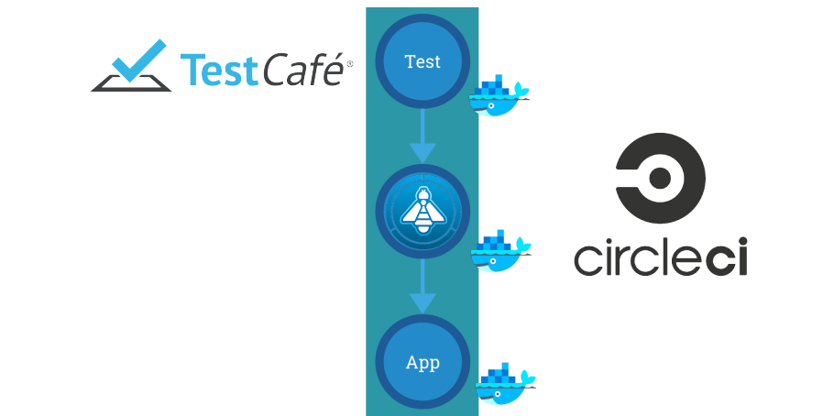
Setup with WAF
Notes:
Franziska
Same tests - with WAF in front of the application
We start a third Docker container
Tests should still be green AND ModSecurity Logs should be empty.

Slide 26
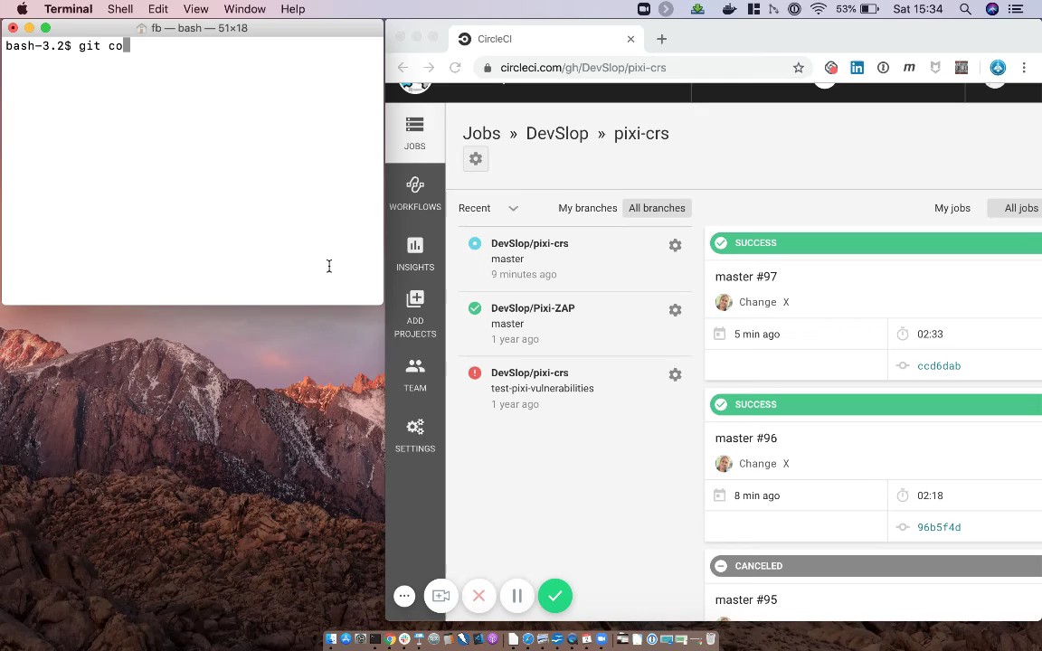
Notes:
Franziska
All these Docker containers are pulled and started - app tests run in less than 3 minutes.
Pull and start CRS container, app tests with CRS and WAF Test -> less than a minute
We do not lose much time but get a lot of extra security.
I think we make everyone happy with a WAF in the pipeline and in production: dev, ops, sec eng

Slide 27
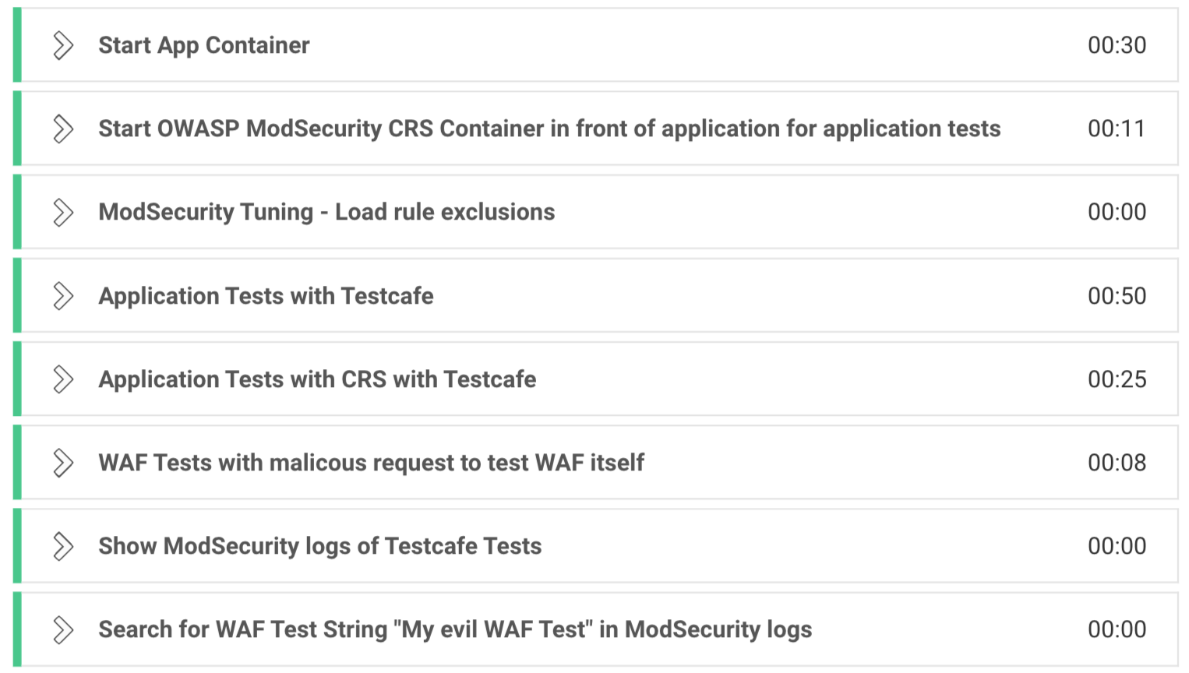
Notes:
Franziska
All these Docker containers are pulled and started - app tests run in less than 3 minutes.
Pull and start CRS container, app tests with CRS and WAF Test -> less than a minute
We do not lose much time but get a lot of extra security.
I think we make everyone happy with a WAF in the pipeline and in production: dev, ops, sec eng

Slide 28
CRS Container
$> docker pull owasp/modsecurity-crs:v3.2-modsec2-apache
$> docker run -dt -e PARANOIA=2 \
-e ALLOWED_METHODS='GET HEAD POST OPTIONS PUT' \
-e ANOMALYIN=1 -e ANOMALYOUT=1 \
-e PROXYLOCATION=http://172.17.0.1:8000/ \
owasp/modsecurity-crs:v3.2-modsec2-apache
Notes:
Franziska
Same tests - with WAF in front of the application
We start a third Docker container
Tests should still be green AND ModSecurity Logs should be empty.

Slide 29
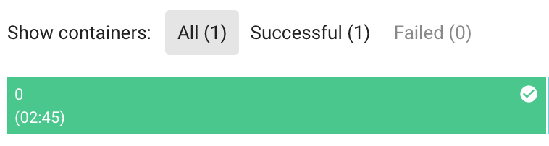
Fast Feedback
Notes:
Franziska
All these Docker containers are pulled and started - app tests run in less than 3 minutes.
Pull and start CRS container, app tests with CRS and WAF Test -> less than a minute
We do not lose much time but get a lot of extra security.
I think we make everyone happy with a WAF in the pipeline and in production: dev, ops, sec eng

Slide 30
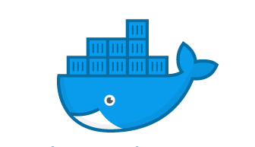



Links / Mail
https://coreruleset.org/
owasp/modsecurity-crs
https://github.com/SpiderLabs/owasp-modsecurity-crs
https://github.com/DevSlop/pixi-crs/tree/master/.circleci
chaim.sanders@gmail.com / buehler@puzzle.ch
Notes:
Franziska / Chaim

